Slide 1
Designing the Questionnaire
MKTG 302-01
Spring Semester, 2025
Scott Beck

Slide 2
Some updates to know …
Individual projects submitted should be graded by tomorrow
Quiz is next Tuesday – NOT in class!
Use Canvas, Lockdown Browser including camera monitor
Decks 4/5* - 10
Thursday is a scheduled working session
Project Description is posted
Reds Game on April 30th is on your Calendar
Please register for “Corporate ConneXions” for Thursday evening @ 6:00 pm
Business Attire Required
+1 point on Final Score for our class
~ 20 great companies

Slide 3
Project Milestones
• Mar 27: First draft of survey is due to me
• Apr 1: Second/Final draft of survey is due. Questionnaires sent to client for review.
• Apr 3: Data collection begins via Qualitrics
• Apr 10: We expect to have surveys completed – total of 100 (min) – 200 (max)
• Apr 15: Students will deliver their 1st draft analysis to Professor
• Apr 24: 2nd draft is due.
• Apr 30: (OPTIONAL) GABP Tour, Cincinnati Reds game – in-person personal interviews with guests, observation research
• May 6: Presentations to client at 8:30 – 10:20am.
BAGELS and COFFEE provided!!!

Slide 4
Student Learning Objectives
Learn how to create great questions using different techniques and forms, and
Prepare well for the client survey for the Reds.

Slide 5
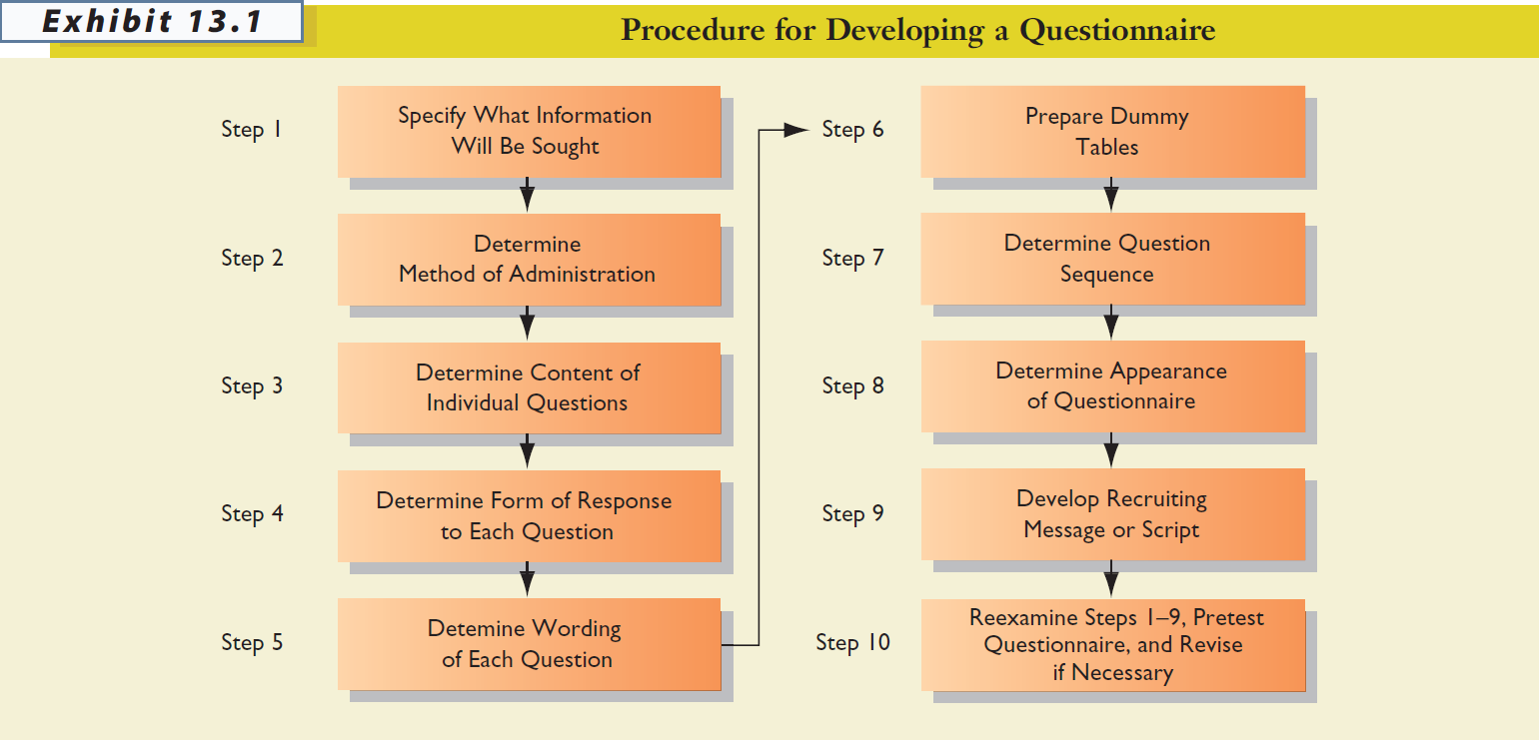
Steps to create a questionnaire

Slide 6
STEP 1: Specify What Information Will Be Sought
The first step should be relatively easy, assuming that the researchers have done a good job at earlier stages in the research process.
Hypotheses, dummy tables, etc., make it clear what information is needed.

Slide 7
Probing Application
Let’s review what the Reds wants to learn?
What did YOU learn?

Slide 8
STEP 2: Determine Method of Administration
The degree of structure and disguise influence this decision, as does the specific research situation.
Personal Interview
Telephone Interview
Mail Survey
Online Survey
What are some relative advantages / disadvantages of each method?

Slide 9
Types of Control-Depends on Method
Sampling Control
Ability to secure a list of population members (allows for random sampling)
Secure response
Response rate
Information Control
Ability to adapt to the situation as needed
Protection from interviewer bias
Ability to obtain personal information
Administrative Control
Costs
Quality control
Personal Interview
Telephone Interview
Mail Survey
Online Survey

Slide 10
STEP 3: Determine Content of Individual Questions
Some key issues:
Is the question necessary?
Are several questions needed instead of one?
Do respondents have the necessary information?
Will respondents give the information?

Slide 11
FILTER / SCREENING QUESTION
A question used to determine if a respondent is likely to possess the knowledge being sought; also used to determine if an individual qualifies as a member of the defined population.
“Do you do the grocery shopping for your family?”
“Have you eaten at Mickey’s restaurant, located at Sixth Street and Manvel Avenue, within the past six months?”
“Did you vote in the last presidential election?”

Slide 12
Common Recall Problems
TELESCOPING ERROR
A type of error resulting from the fact that most people remember an event as having occurred more recently than it did.
RECALL LOSS
A type of error caused by a respondent’s forgetting that an event happened at all.

Slide 13
Handling Sensitive Questions
Don’t ask unless absolutely necessary!
Guarantee anonymity
Place sensitive questions near end
Include a counterbiasing statement
Ask about how others might feel
Ask for general, rather than specific, information (e.g., categories for answers)
Use randomized response model

Slide 14
Counterbiasing Statement
Recent studies show that one of every four households has trouble meeting its monthly financial obligations. Is your household currently experiencing financial difficulties?
Yes
No

Slide 15
STEP 4: Determine Form of Response to Each Question
Open-Ended Questions
versus
Closed-Ended Questions
Structure!!!

Slide 16
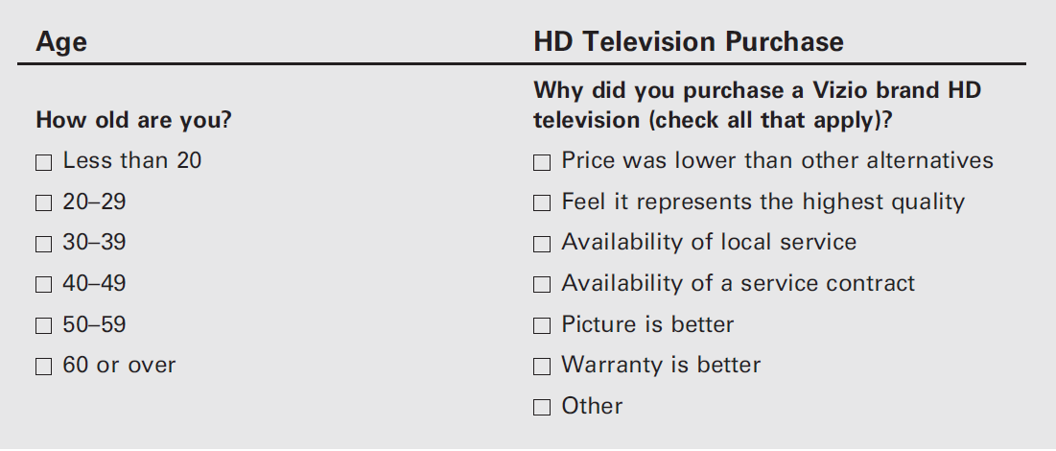
Closed-Ended Questions

Slide 17
Closed-Ended Questions
With closed-ended questions, the response categories must be exhaustive; all reasonable responses must be included.
In addition, response categories must be mutually-exclusive, except in special cases where more than one answer is acceptable (e.g., check all that apply)

Slide 18
BAD Questions
How many times have you shopped at Kroger in the last 2 weeks?
1 or 2
2 or 3
3 or 4
4 or 5
Where did you do your most recent grocery shopping?
Kroger
Whole Foods
Walmart

Slide 19
Open-Ended Questions
How old are you? ___________ years
Do you intend to buy a car this year?
In the past month, how many times have you purchased gasoline from Kroger? ______
How satisfied were you with your dining experience at E&O this evening?
Why did you choose to attend Xavier University?
Turn each of the questions above into a closed-ended question

Slide 20
RESPONSE ORDER BIAS
An error that occurs when the response to a question is influenced by the order in which the alternatives are presented.
Now, with Qualtrics, we can randomize the order in which answers are presented to avoid this issue.

Slide 21


Slide 22
Determine Wording of Each Question
Use simple words
Language used should be driven by the ability level of the population; err on the side of simplicity

Slide 23
Avoid Ambiguous Words and Questions
How often do you use Venmo to transfer money?
_____Never
_____Rarely
_____Sometimes
_____Often
_____Always
versus
In the last 2 weeks, how many transactions have you completed using Venmo? ________
Notes:
8:30 stopped here

Slide 24
Some Problem Words: Be Careful!
All
Always
And
Dinner
Feel
Government
If
Never
Occasionally
Often
Or
Rarely
Regularly
Sometimes
Usually
Where
You

Slide 25
Avoid Leading Questions

Slide 26
REMINDER: No Advocacy Research!
Reputable media outlets provide (a) the actual questions, (b) a description of the study, and (c) information about the sample
Advocacy research is a type of research that generates evidence and arguments to support a specific position or cause. The goal of advocacy research is to influence the policies of policymakers and others in power.

Slide 27
Words that Might Signal Leading Questions
Allege, allude, arbitrary, blame, claim, demand, error, failure, fault, ignore, ill-advised, ill-informed, incompetence, ineptness, insist, just, maintain, misinformed, must, neglected, one-sided, only, overreact, peremptory, purport, questionable, rejection, rigid, so-called, unfortunately, unilateral, unreasonable
Source: “Guide to Writing Survey Questions,” Management Analysis and Development, downloaded from http://www.mad.state.mn.us/ on October 25, 2012.

Slide 28
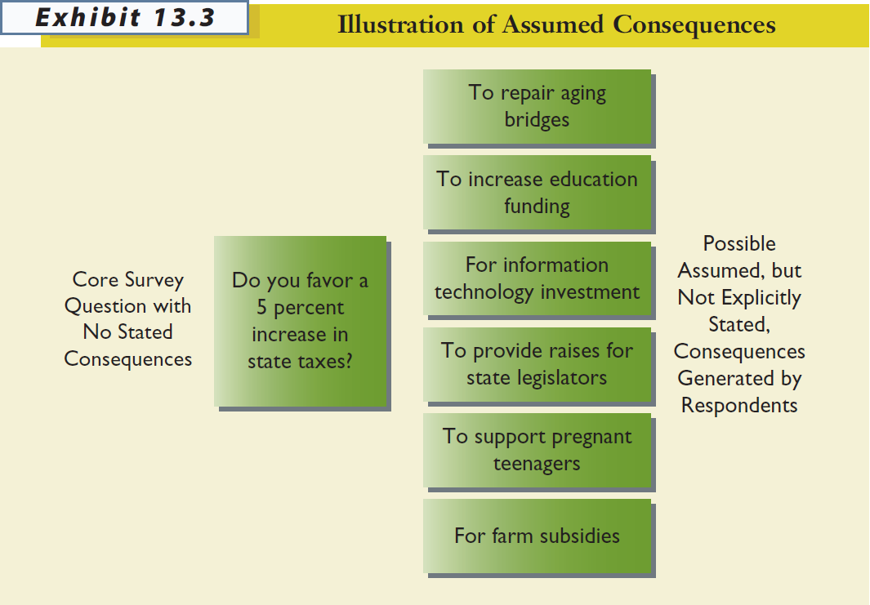
Avoid Assumed Consequences
When a question is not framed to clearly state the consequences and thus generates different responses from individuals who assume different consequences.

Slide 29
Avoid Generalizations and Estimates
Questions should always be asked in specific, rather than general, terms.
When asking about the frequency of behaviors (e.g., shopping, purchase), use an appropriate time frame that doesn’t force respondents to make estimates.

Slide 30
Avoid Double-Barreled Questions
Watch out for and and or…
Notes:
10AM stopped here

Slide 31
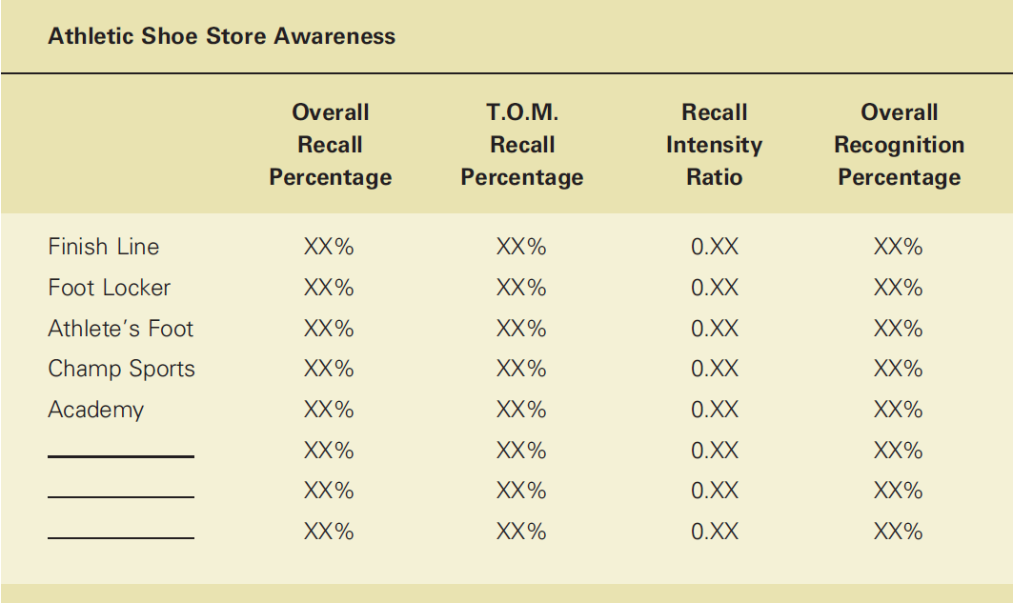
Step 6: Prepare Dummy Tables
DUMMY TABLE
A table (or figure) used to show how the results of an analysis will be presented.

Slide 32
STEP 7: Determine Question Sequence
Use simple and interesting opening questions
Use the funnel approach
Start with broad questions and progressively narrow the scope
Question Order Bias: The tendency for earlier questions on a questionnaire to influence respondents’ answers to later questions.

Slide 33
Question Sequence cont…
Design branching questions with care
Branching questions direct respondents to different places in a questionnaire, based on their responses to the question at hand
Ask for classification information last
Target Information: The basic information that addresses the subject of the study
Classification Information: Information used to classify respondents, typically for demographic breakdowns
Place difficult or sensitive questions late in the questionnaire

Slide 34
STEP 8: Determine Appearance of Questionnaire
No clutter!
Keep it as short as possible
Use care with branching questions
Use graphics as needed to improve appearance
Include page breaks
Keep similar questions together
Include an organization name (sometimes fictitious) and project title
Go easy on instructions, unless they are absolutely necessary

Slide 35
STEP 9: Develop Recruiting Message or Script
Good cover letters and scripts are NOT written in a hurry.
The usual things to include:
Who you are
Why you are contacting them
Promise of anonymity or confidentiality
The request for help
How long it will take
Any incentives

Slide 36
STEP 10: Reexamine Steps 1-9, Pretest Questionnaire, and Revise If Necessary
Developing a questionnaire is a VERY difficult process. It normally requires several revisions of the data collection form.
PRETEST
Use of a questionnaire (or observation form) on a trial basis in a small pilot study to determine how well the questionnaire (or observation form) works.

Slide 37
Pretesting
The real test of a questionnaire is how it performs under actual conditions of data collection.
Data collection should NEVER begin until you have pretested – and probably revised again – the questionnaire.

Slide 38
Next Time
We will start working on your team survey to be administered through Qualtrics!

Slide 39


